Slide 1

Nutri-Snap:
A Nutritional Aid
Dennis Zax
Gordon Ng
Suhas Poturaju
Carlos Lopez
Project By:

Slide 2
Inspiration
- As of 2019, 40%
of young adults in America were reported as obese, and with discrepancies in
weath, this statistic in health is worse due to COVID-19
Nutrition is complicated and is a science specific to every individual
Keeping track of calories can be overwhelming.
Nutriologists, health professional, are expensive and not cheap.
The average person has resolutions to lose weight.
By limiting certain nutrients AND/OR
By engaging in physical activity
Notes:
Carlos

Slide 3
What is it?
Nutri-Snap aims to keep users healthy
and fit by the combination of new technology and accurate nutrition.
(example: tilapia really isn’t that bad in macro-nutrients: good source of protein)
It provides a hassle-free method to track calories and macronutrients such as carbohydrates, fats and proteins.
A built in pedometer tracks steps which can then calculate the amount of calories burned that day.
Red reminders when the user reaches the nutrient limit for the day.
Notes:
Suhas
Nutrisnap combines new technology and nutrition to track calories, carbs, fats and proteins in the easiest way possible. A built in pedometer can tracks steps and calculate the calories burned. Finally the progress bar turns red, when you have reached the nutrient limit for the day.

Slide 4
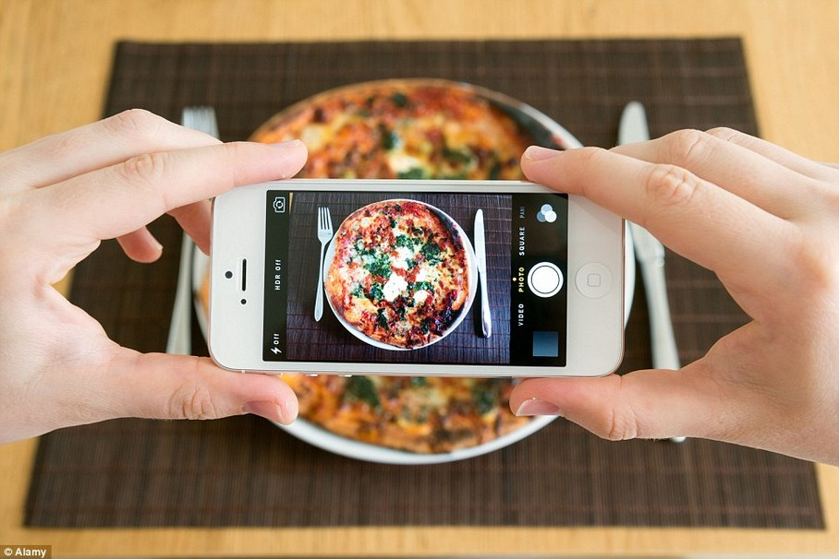
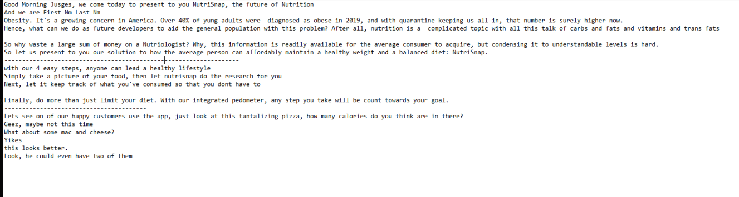
Elevator Pitch: Summary
Let Nutri-Snap
do the research on your food,
for you, so you only eat the best.
Snap A Picture Of Your Food
4
Easy
Steps
Keep track of what you’ve consumed without the hassle of writing notes.
DO MORE! Take to the outside with our built-in pedometer
Just see how many extra calories you could evict

Slide 5

Demo
Notes:
Let me introduce you to our welcome page.
Let’s see our happy customers use the app. Chris is not happy with his body weight. He is unsure if he should eat fish or steak for dinner, or that tantalizing pizza. If the food is that photogenic, let’s take a picture. How about something else, some macaroni and spaghetti? Oh well, turns out chris couldn't even have two ceasar salads, as he is done for the day.

Slide 6
Behind the Scenes
Frontend
UI designed on Adobe XD
Mobile app built with react-native (not react)
Backend
Flask and ngrok for the server
Tensorflow/Keras for the food recognition
Interactions with the Nutritionix API and the edamam food-database API.
Demonstration : Expo for back-testing.
Notes:
Dennis -The UI was initially created with Adobe XD. We then implemented that design with react-native to deploy on mobile devices. The Backend consists of a server to handle requests and api calls which is built with flask/ngrok, the other part consists of a ML model for food recognition built with tensorflow/keras.

Slide 7
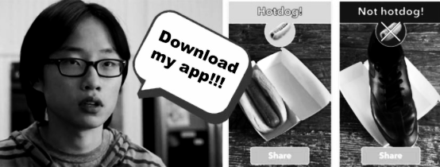
Future Implementations
❋ Add more food options to recognize.
❋ Integrate firebase to create a login system
❋ Website to view your detailed data online
❋ Weight loss/gain grapher
❋ Generate personal plan
❋ Implement text-to-speech for better accessibility
❋ Emotional API detector for your food cravings
❋ Social Aspect for weight-lifters on diets
❋ Vegetarian and Kosher app customizations
❋ An even better UI/UX option (yelp, maps, and more)
⧖
⧖
Notes:
Now that you've seen what we have gone through,
here's what we CAN ALSO do.
To expand our business opportunities we want to expand
for those in specific niches in aspects of life, text-to-speech for accessibility, kosher options for religious aspects, and we want nutriologist-grade accurate information.There's more opportunities
if we expand into food delivery, emotional food addictions, and we will support fitness recreations and strive for better health.
Our future investors will see the expansive business plan we have created, and our value. Thank you for listening.

